Slide 1
Craft of Data Visualization
Visualizing Geodata
Alexey Zaytsev,
Skoltech, CDISE
18 January
Slides are based on https://serialmentor.com/dataviz/geospatial-data.html

Slide 2
Overview
Basics: projections
Working with multiple layers
Specific plot types:
Choropleth mapping
Cartograms

Slide 3
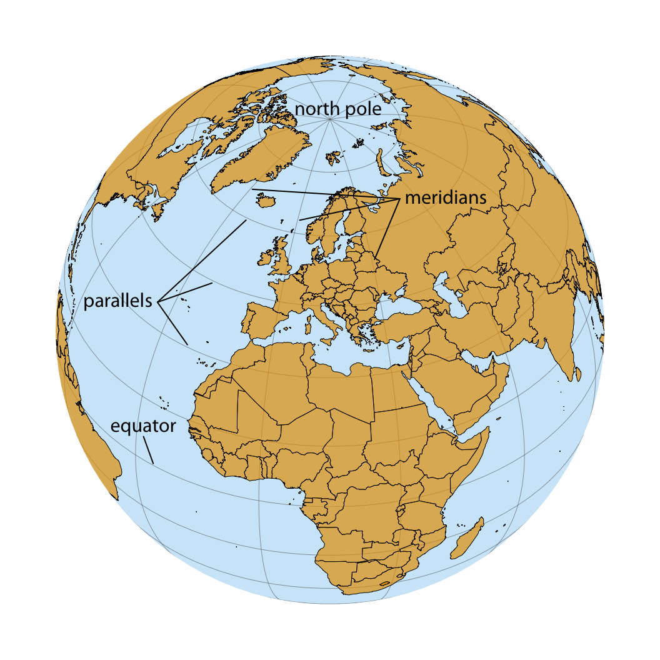
The earth is approximately a sphere
To specify a location on the earth, we need:
where we are located along the direction of the equator (the longitude),
how close we are to either pole when moving perpendicular to the equator (the latitude),
how far we are from the earth’s center (the altitude).

Slide 4
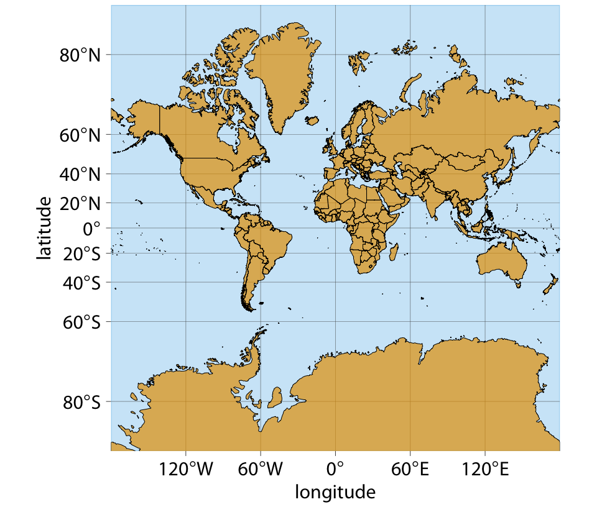
The Mercator projection
Developed in the 16th century for nautical navigation
A conformal projection
Accurately represents shapes
Has severe area distortions

Slide 5
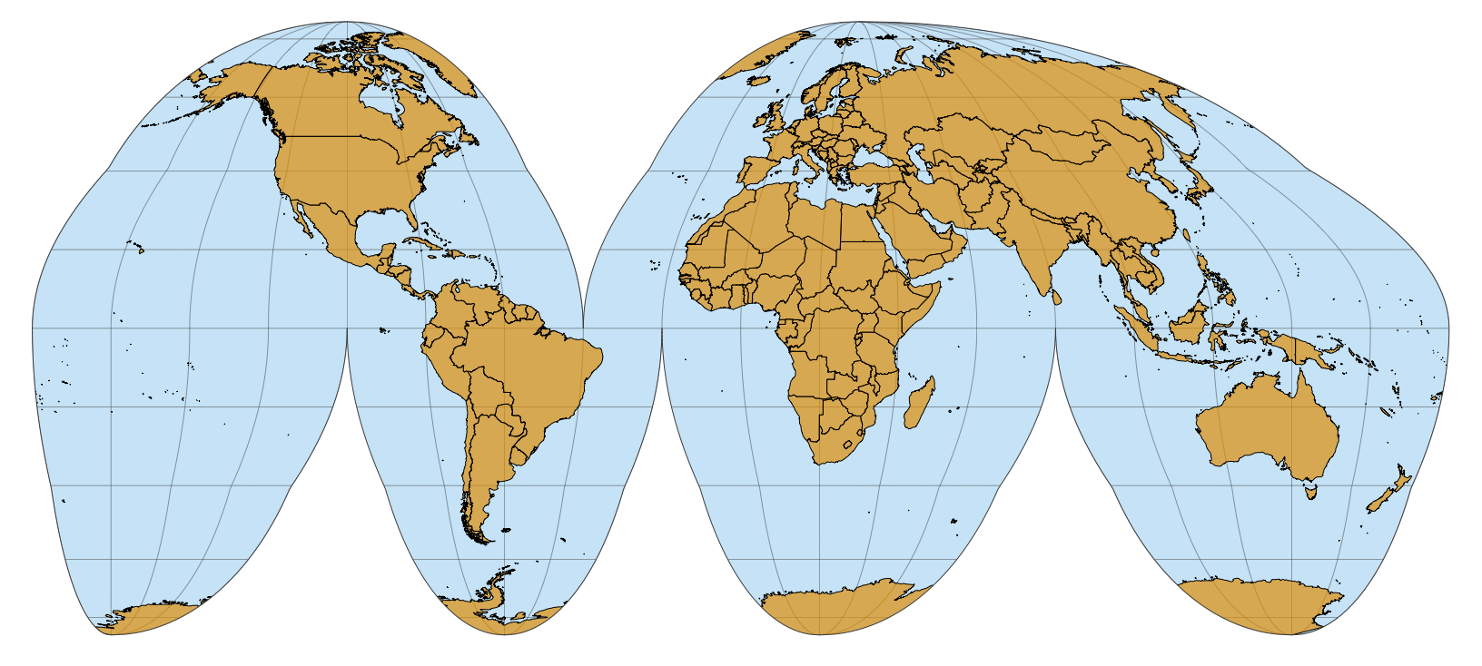
The Goode homolosine
Developed in 1923 by Goode for nautical navigation
A conformal projection
preserve areas
approximately preserve angle

Slide 6
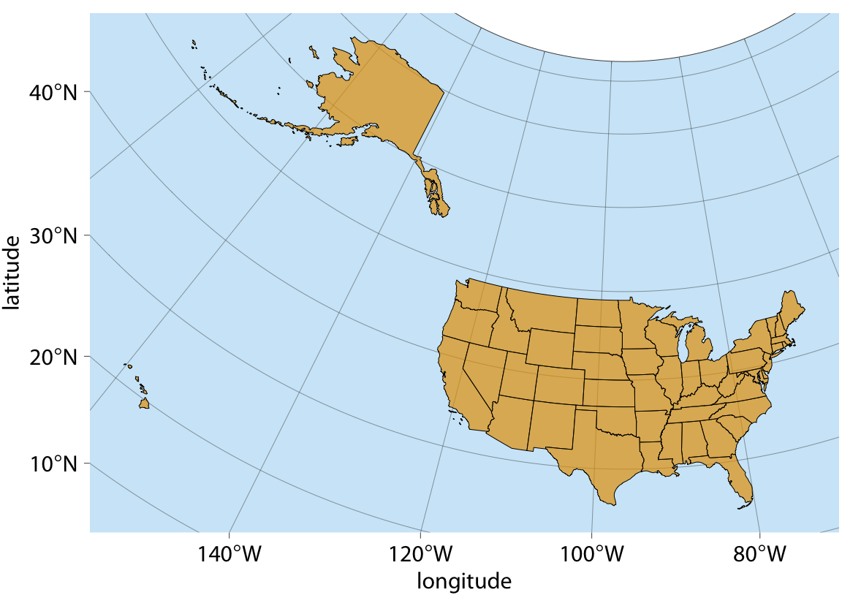
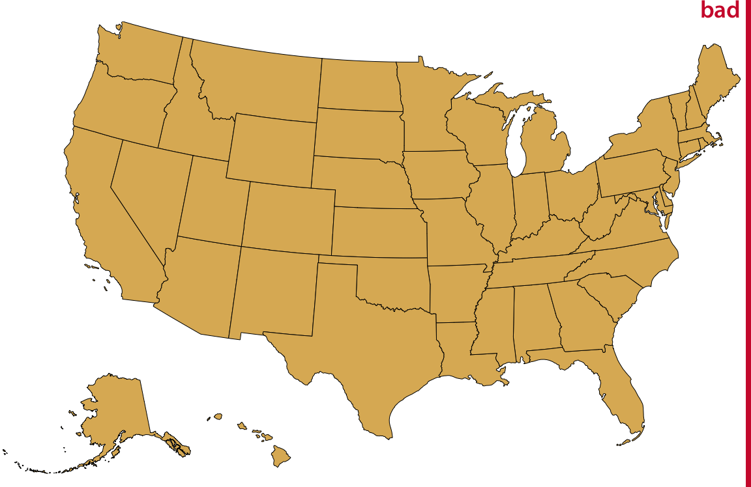
There can be projection problems even for one country

Slide 7
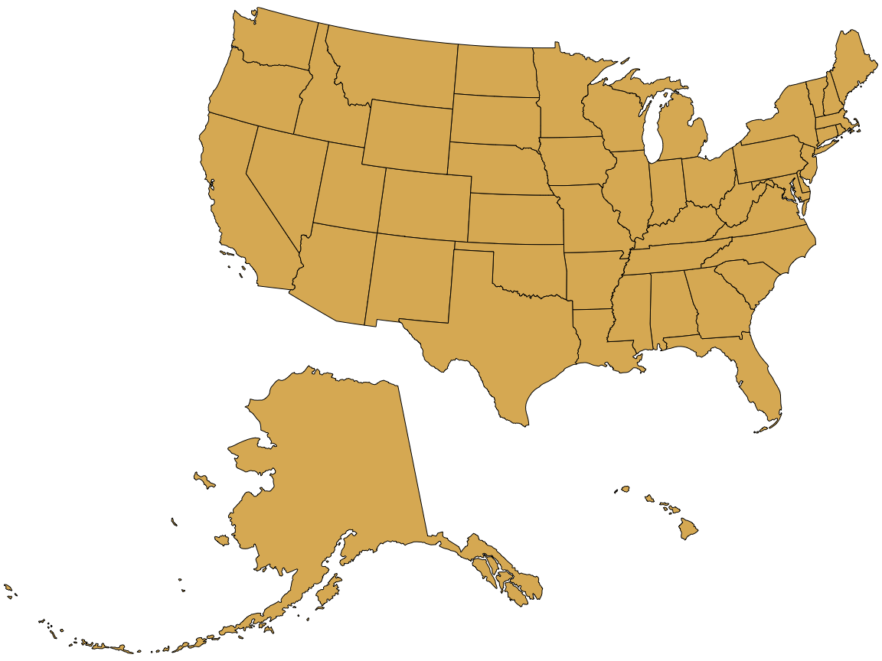
There can be projection problems even for one country

Slide 8
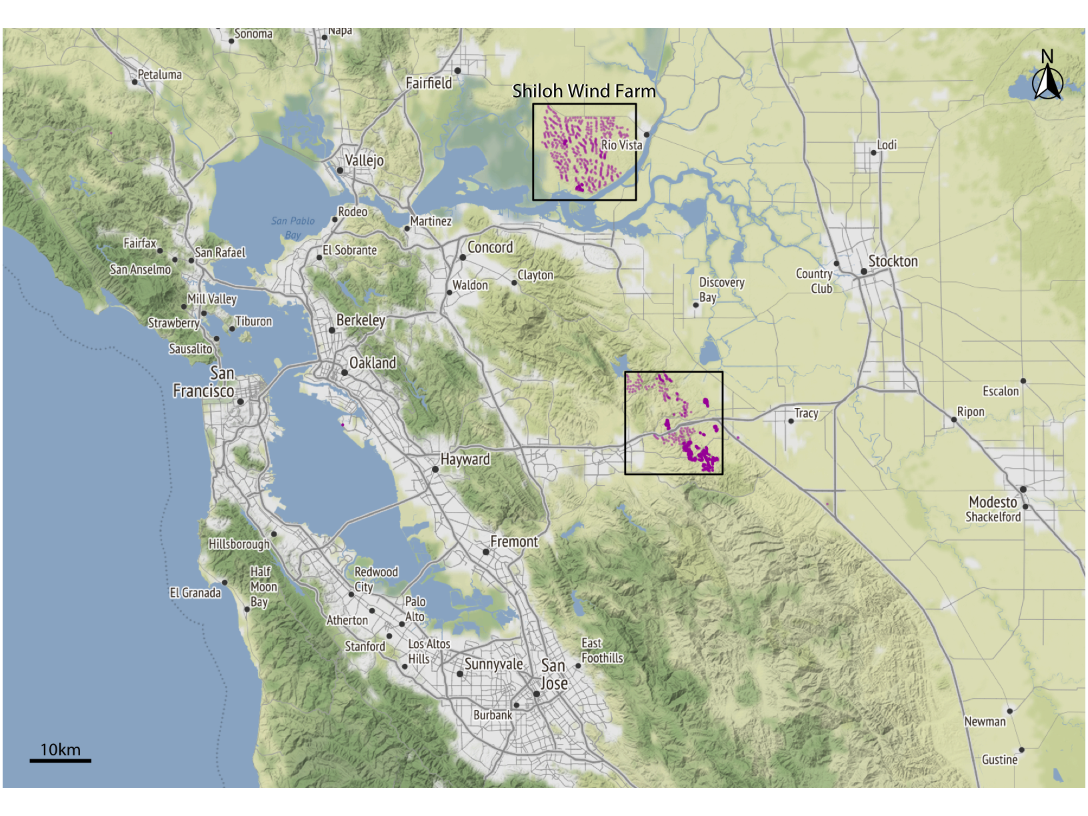
Typical map consists of a number of layers

Slide 9
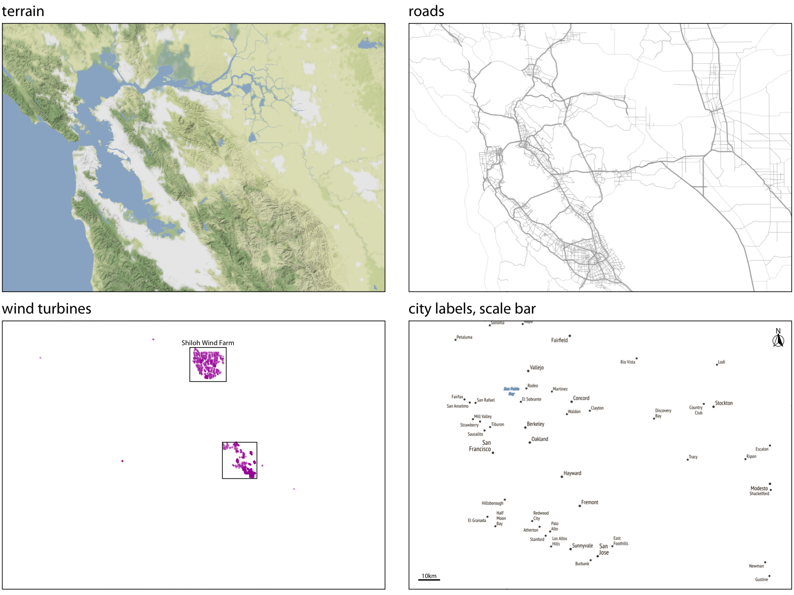
Typical map consists of a number of layers

Slide 10
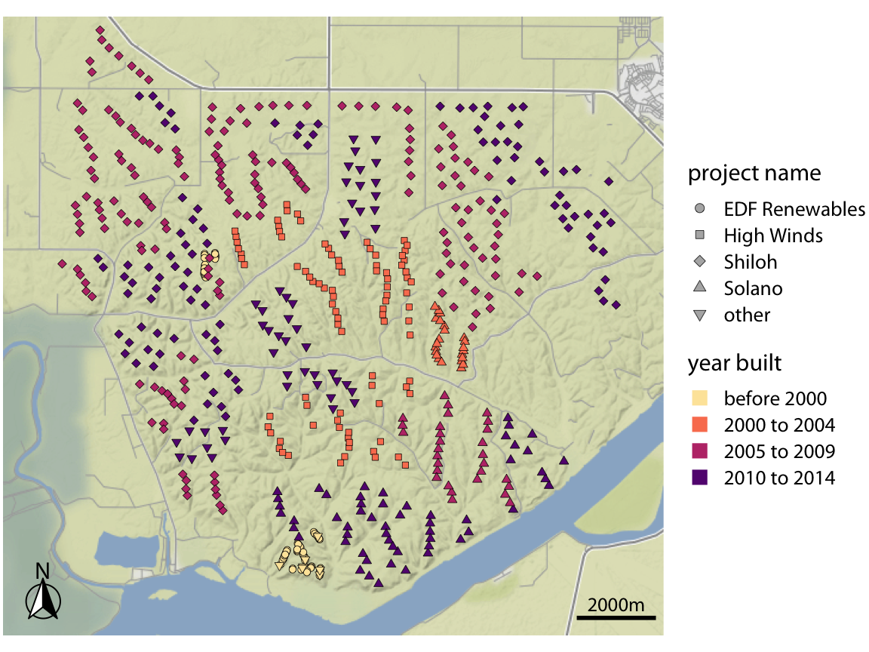
When plotting maps we use the same principles
We use color and shapes
The message is the process of development of wind turbines

Slide 11
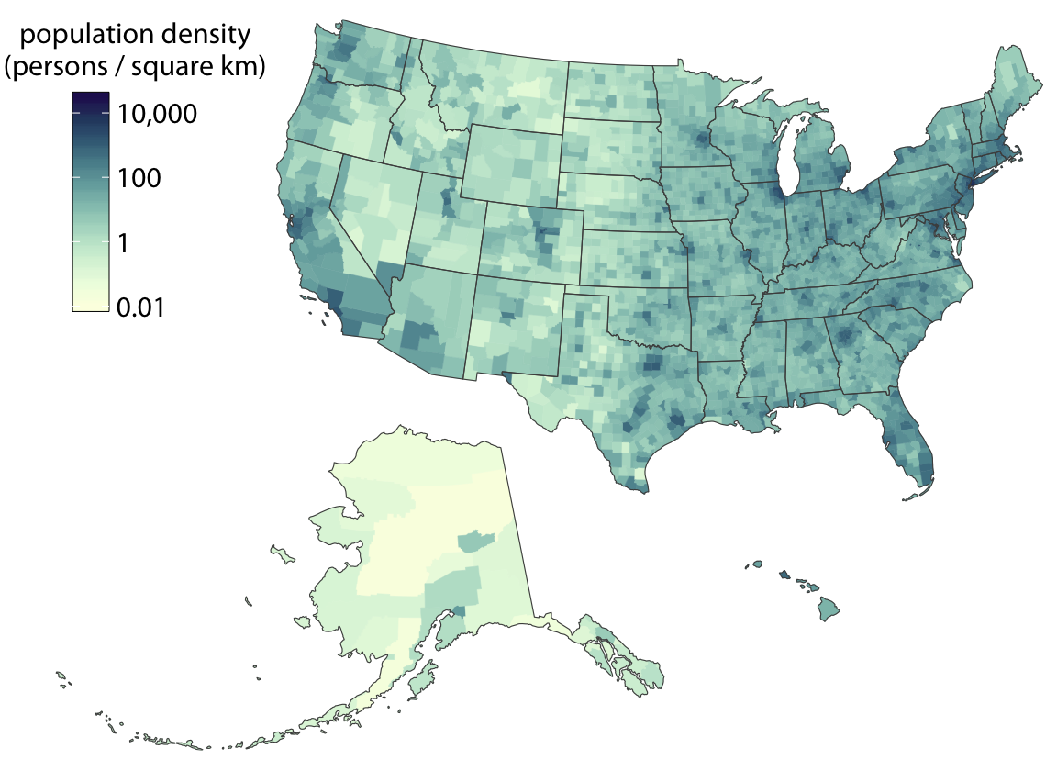
Choropleth mapping is a popular way to display information with maps
We want to show how some quantity varies across locations.
We color individual regions in a map according to the data dimension we display.
We get choropleth maps.

Slide 12
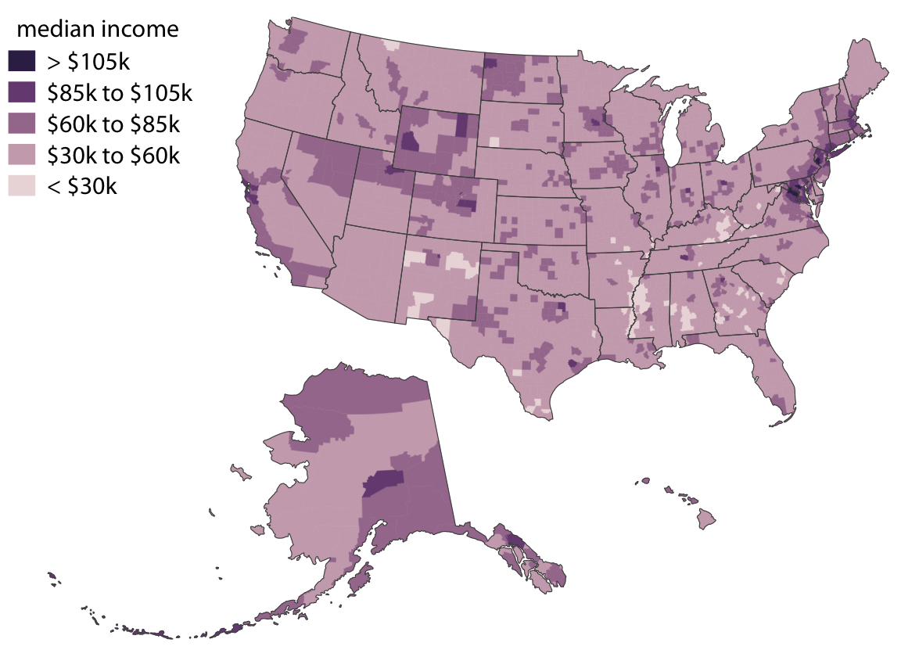
A good idea is to use binned color scale

Slide 13
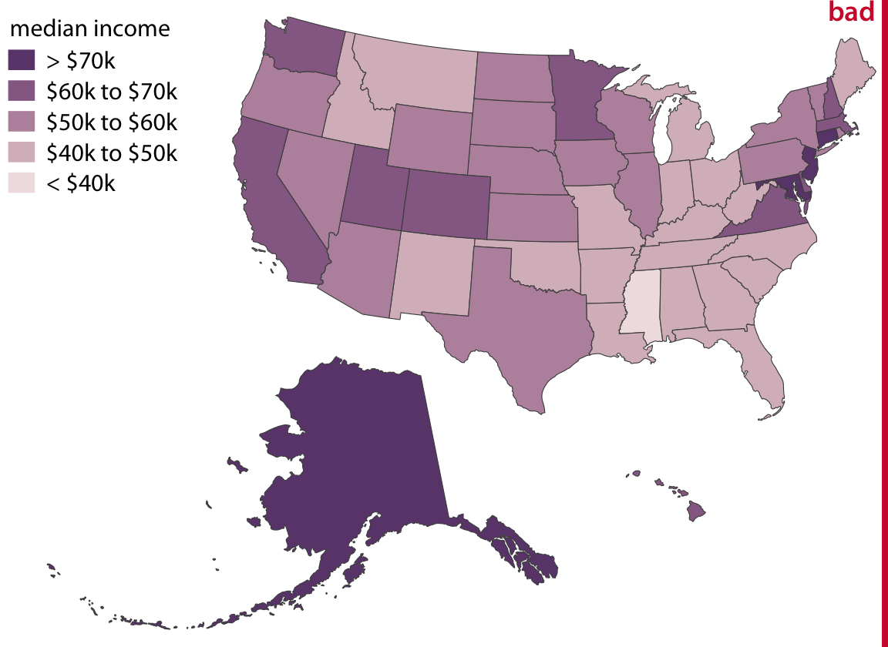
If areas are unequal than perception is wrong

Slide 14
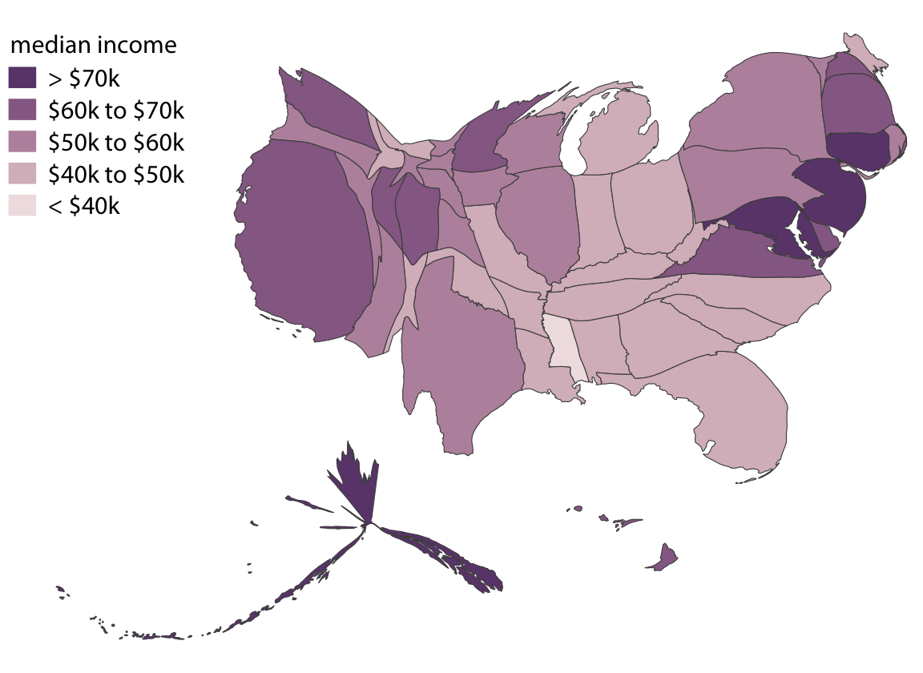
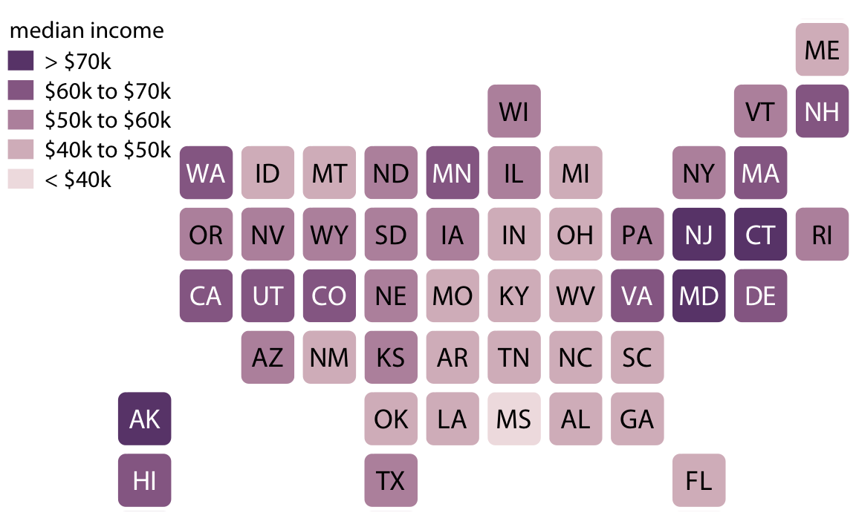
Cartograms work well in this case

Slide 15
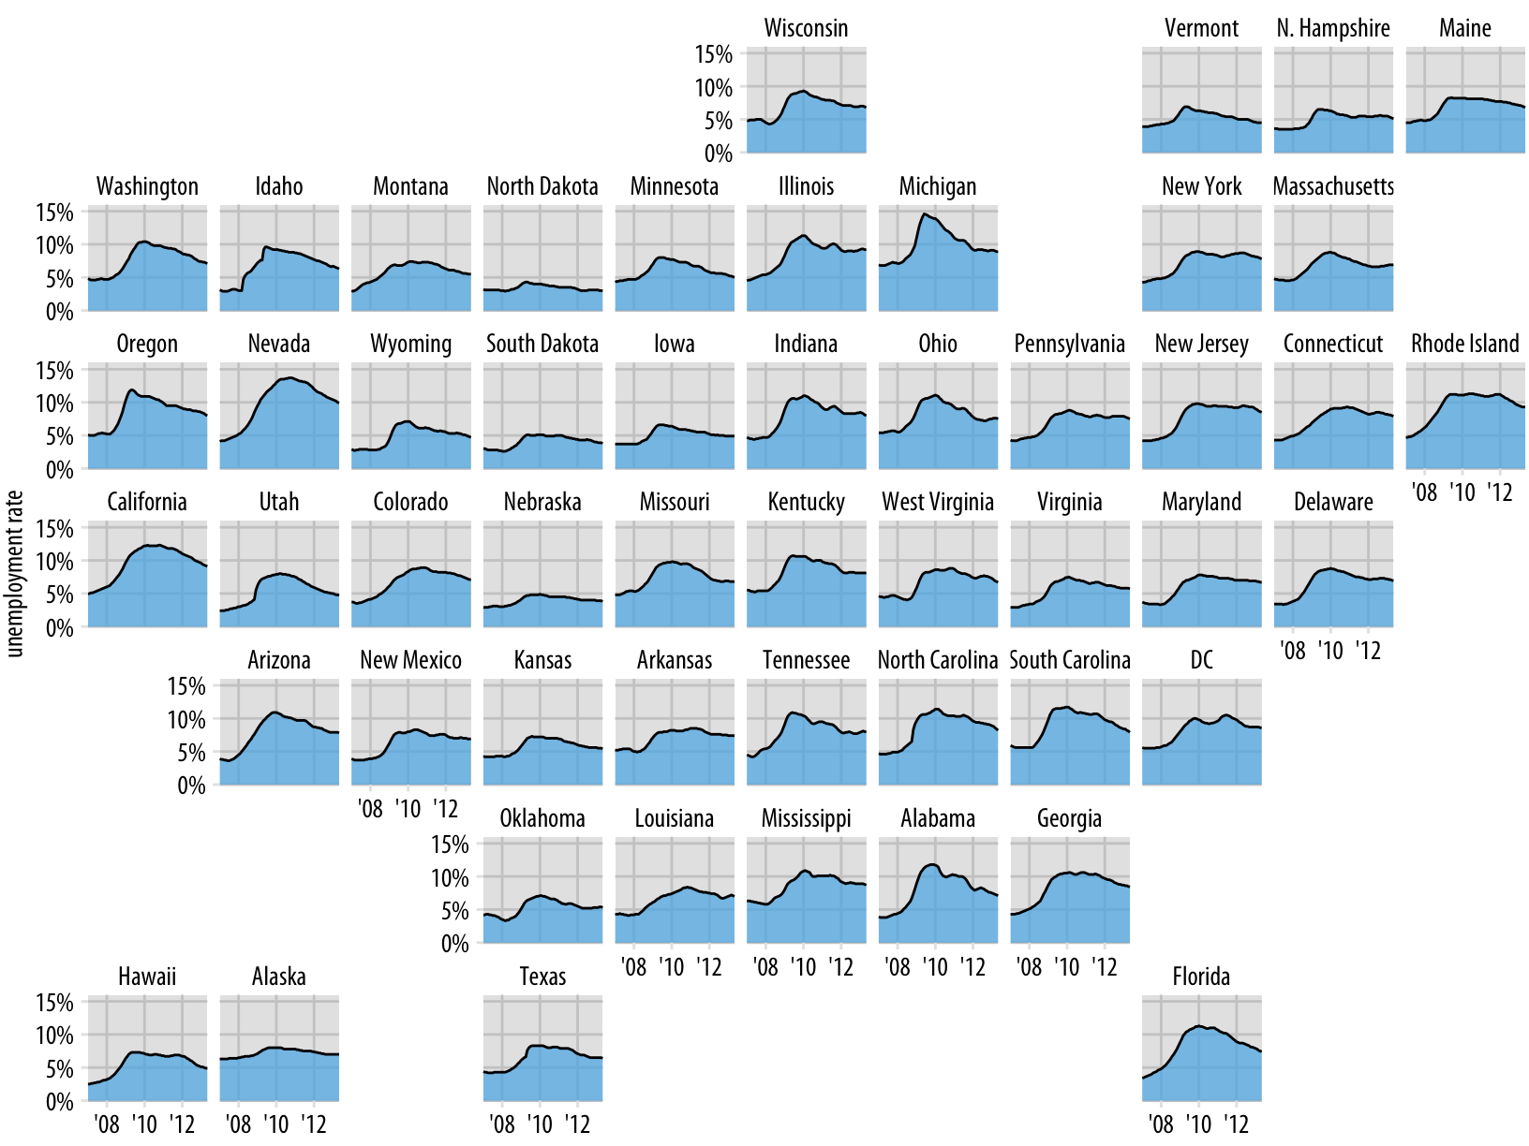
Using cartograms we can display more complex concepts

Slide 16
Messages to take home
Pay attention to projections issues for maps of large region
Keep in mind common principles of visuals design
Some specific plot types are more effective in this case

